Slide 1
Love Reading Celebrate Books
Notes:
Reading is so much more than a skill and it’s much more than something you learn to do in school. Books are powerful and reading is something to enjoy.

Slide 2
Reading for Pleasure
Fascinating facts
Your own life reflected
Insight into other people’s lives
Travel the world without leaving home
Escape from reality
A film in your mind’s eye
The satisfaction of finishing a book
The chance to slow down in a busy world
Travel in time
Notes:
What’s so pleasurable about reading? [in no particular order]
The chance to slow down in a busy world
The satisfaction of finishing a book
The chance to learn fascinating facts
Being able to see your own world reflected in a book
Being able to travel the world without leaving your house
Getting a glimpse of other people’s lives
Escaping from reality
Travelling through time
It can be like seeing a film or TV programme in your mind’s eye
All you need is a book. It won’t run out of batteries or need to be plugged in, and you can borrow books for free from the library.

Slide 3
Our books
Notes:
Staff to share books that they’ve enjoyed recently or old favourites and explain why.

Slide 4
What if I don’t enjoy reading … yet?
Fantasy or sci-fi
Factual or reference books
Poetry
Wordless picture books
Cli-fi
Biographies
Graphic novels and comics
Picture books
Notes:
Sometimes it can take time and experimenting with different types of books and different authors before you find the books that suit you, and there’s nothing wrong with that.
Here are some different types of books that you could try:
Factual or reference books
Poetry
Fantasy or sci-fi books
Wordless picture books
Graphic novels and comics
Biographies
Nature books and cli-fi (climate fiction)
Picture books
Nobody should feel embarrassed or bad about what they enjoy reading, differing tastes is a good thing. Everybody’s different and have different reading appetites, and there’s a perfect book out there for everyone.

Slide 5
The book that made me a reader
Notes:
If there are any members of staff who weren’t always readers but are now, this is an opportunity for them to explain that and share the book that made them a reader and why.

Slide 6
A whole day to celebrate books and reading…
…but we don’t have to wait until then
Notes:
World Book Day® is an annual celebration of reading for pleasure.
Where? Countries world-wide celebrate World Book Day®, but not everybody marks it on the same day.
When? In Britain and Ireland, the first Thursday of March.
Why? To promote and celebrate reading for pleasure.

Slide 7
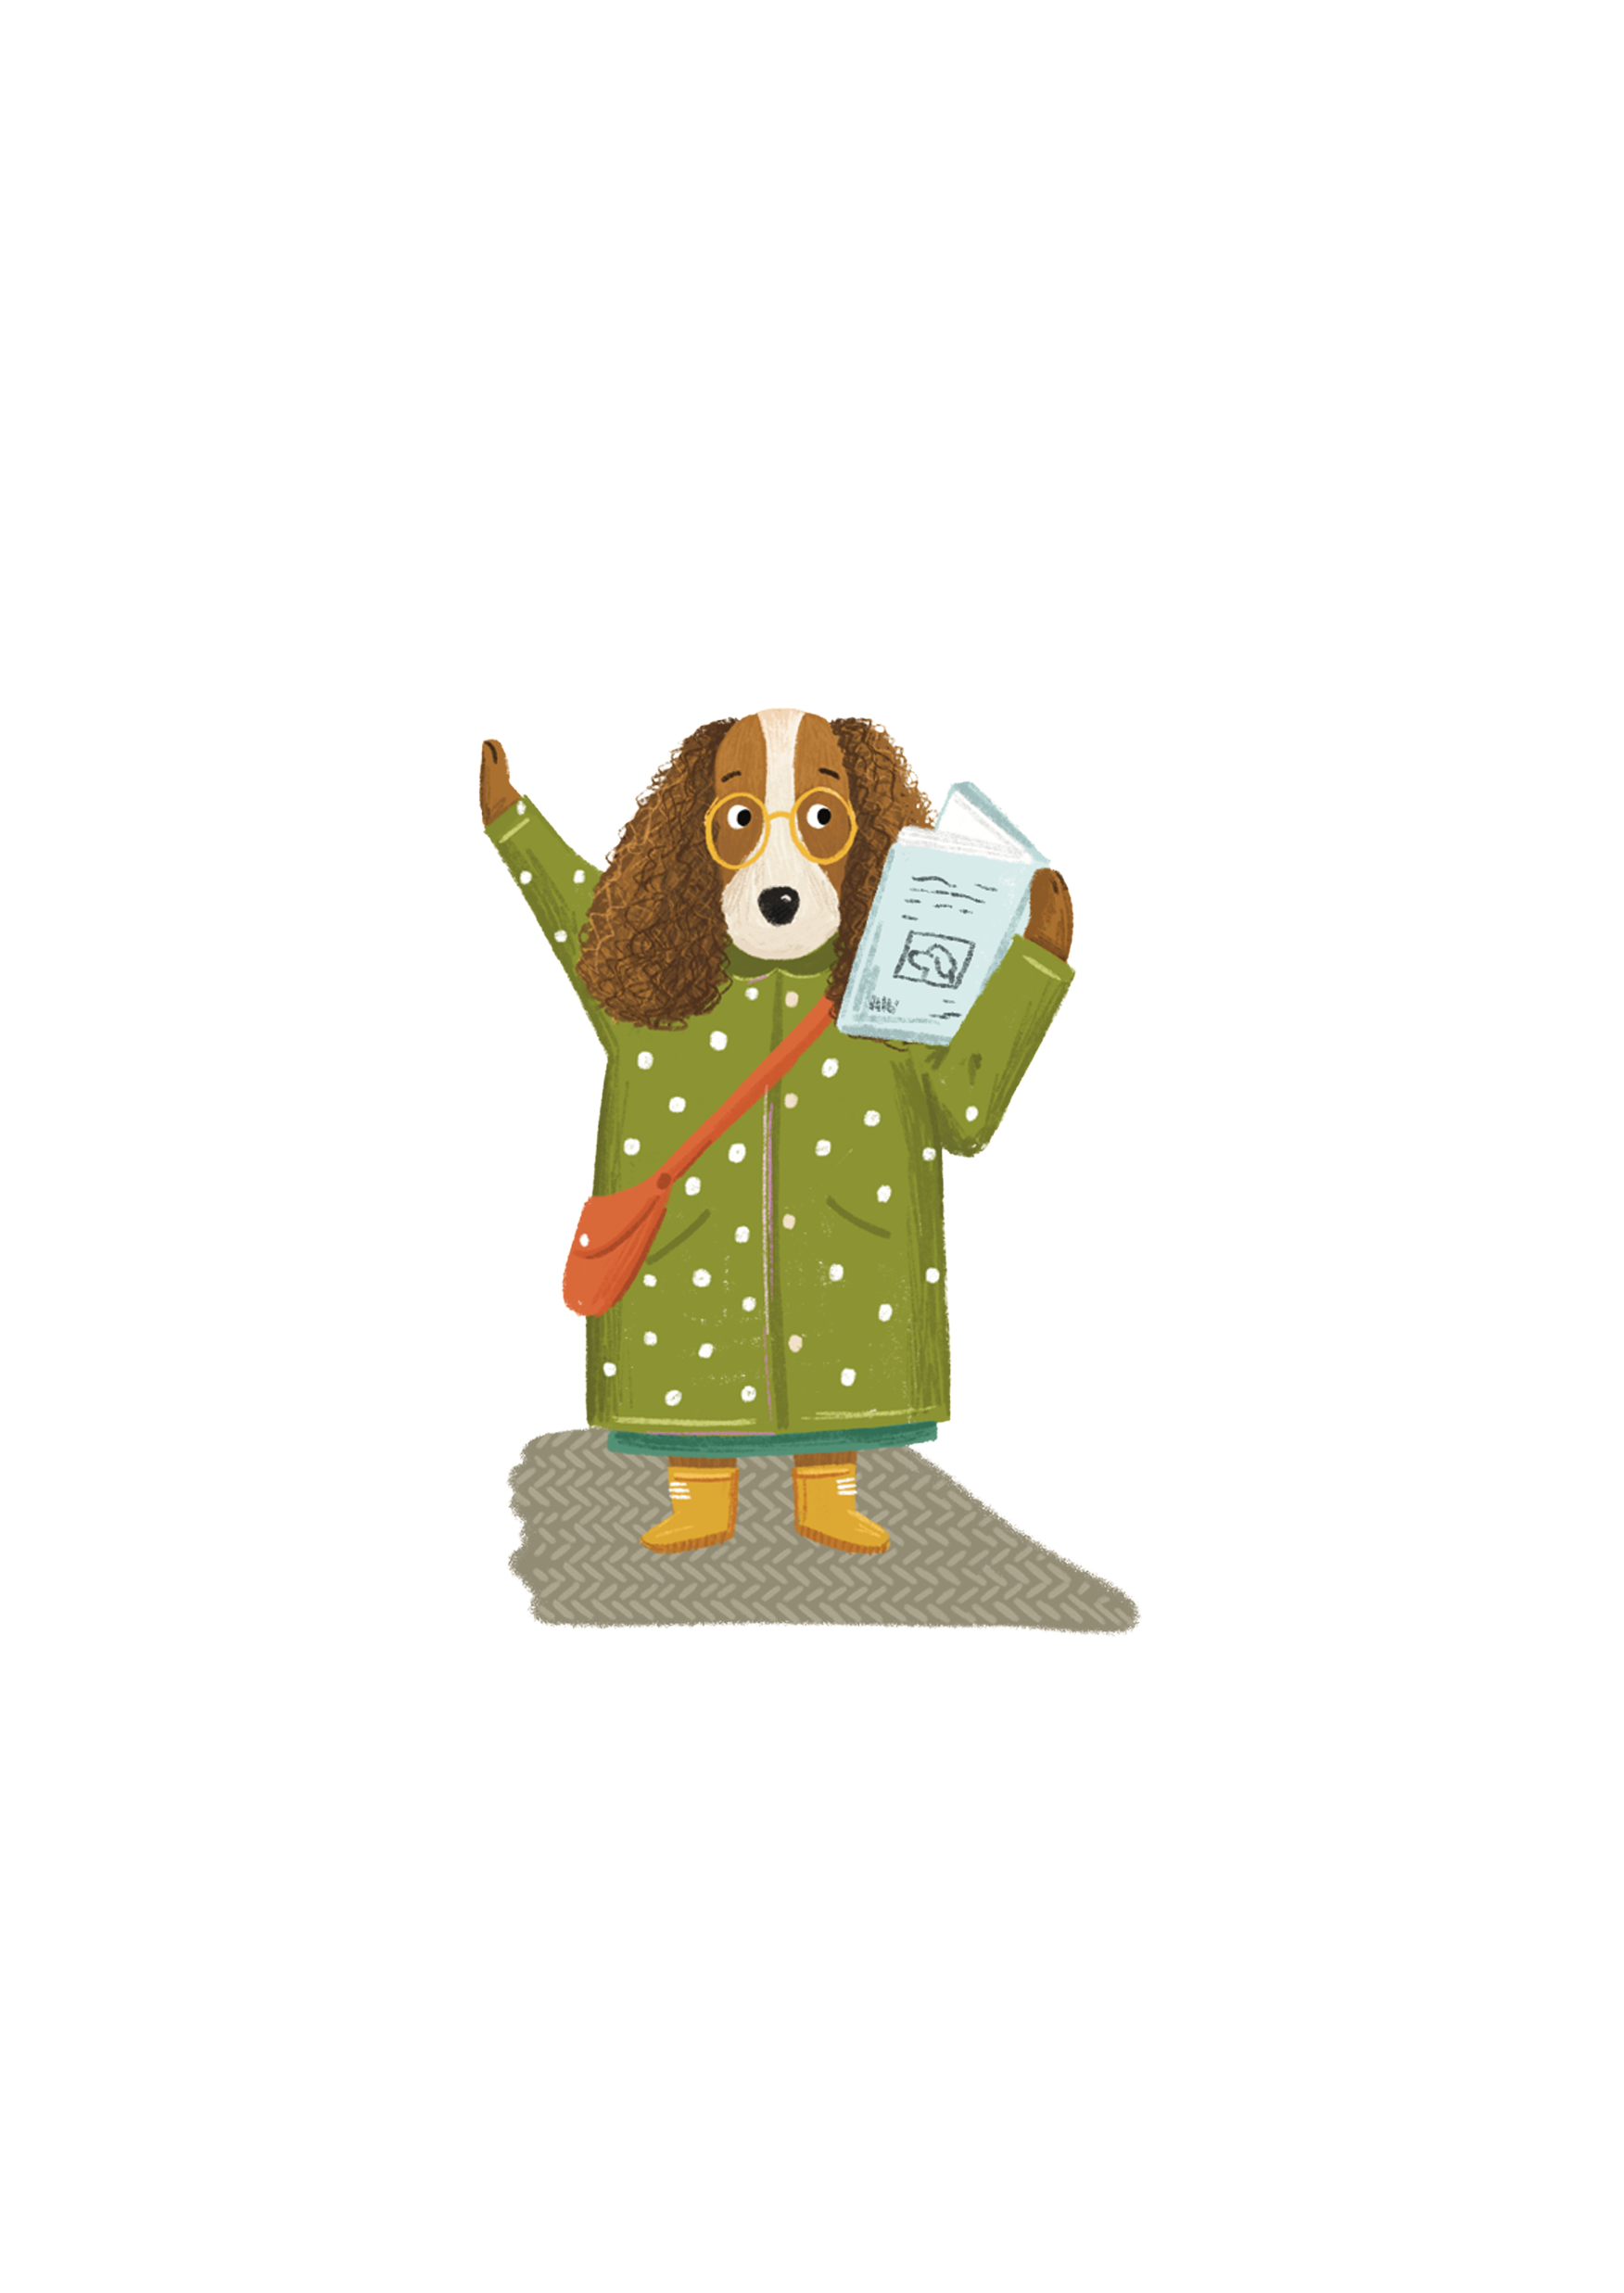
What could we do to celebrate books and reading every day?
Notes:
Share book recommendations with our friends and teachers
Everyone in the class, including the Teacher, to read for 20-30 minutes every day
Listen to someone else reading to us
Go to the local library
Go to the school library more often
WHAT OTHER IDEAS DO YOU HAVE?

